Slide 1

Angular js
Forms
Author : Gauthier PEEL

Slide 2
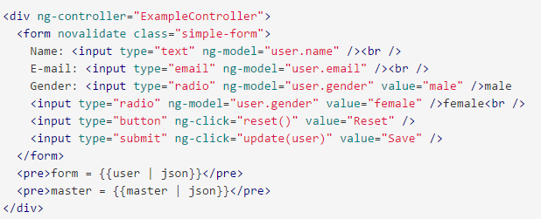
Un formulaire
Utilisation de ng-model pour le double bindning
novalidate (attributes defined in HTML 5) => disables the browser automatic validation
Check the HTML5 types : text, email, number …
type="mail" prevents an invalid value to be synced with the binding data defined in ng-model user.mail if not valid
Notes:
on the plunk
We see how to use the ng-valid ng-invalid ng-touched etc class that NG sets on the fields

Slide 3
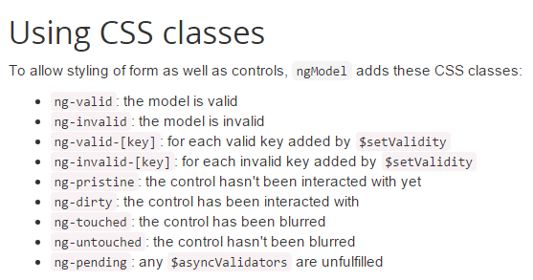
Les classes CSS associées à un formulaire
On user inputs, Angular adds and removes classes from HTML elements
On the <form> element you have one more property :

Slide 4
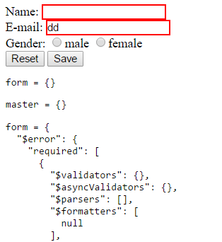

Form/Input state impact on CSS
Angular applies CSS styles automatically according to state
To get impact on the page, we just have to define the content of those CSS

Slide 5
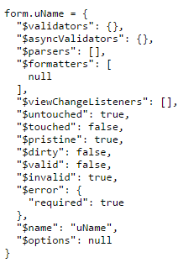
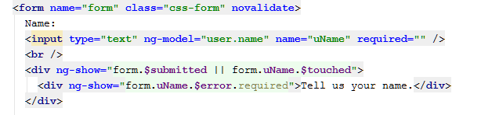

La mécanique interne
In our example, 'form' is an instance of FormController a specifc Angular js object, which has been made accessible by giving it a name on the current $scope
An ngModel directive holds an instance of NgModelController, and could also be named.

Slide 6
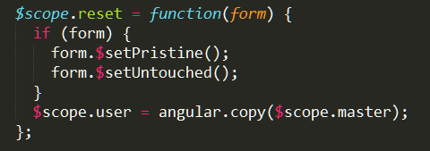
Accessing form/input properties by JS code
Those attributes could be set in JS code :

Slide 7


Affichage de message d’erreur
Comment afficher un message
Et en version simple avec ng-message :

Slide 8
ngMessages
Setup : ngMessages should be added to modules deps : And also as an added script :
Showing error message : ng-message
By default, ng-message shows only one message at a time and this depending on the priority of the messages within the template. Change this behavior by adding the ng-messages-multiple or multiple attribute on the directive container.
For a specific field : ng-messages="<formName>.<fieldname>.$error
For the entire form errors : ng-messages="<formName>.$error

Slide 9
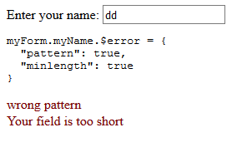
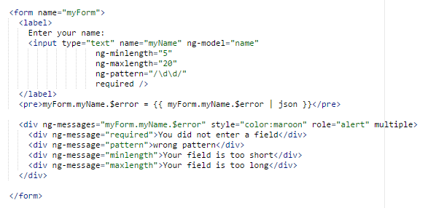
Exemple MultiPLE message
(modified) angular doc plunk example from :
https://docs.angularjs.org/api/ngMessages/directive/ngMessages

Slide 10
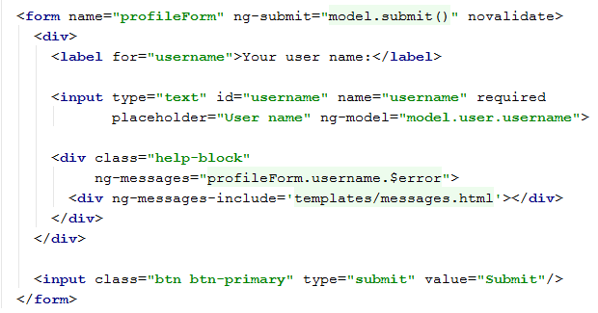

BETTER factorisation : ng-messages extracting messages in a file
the file templates/message.html

Slide 11
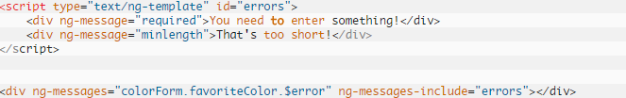
ng-messages extracting messages in a file
the message template file could even be defined inline :

Slide 12
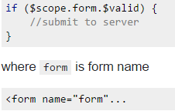
Preventing submit when the form is NOT valid
JS
HTML

Slide 13
Adding Validation
HTML5 validation attributes are :
Technical : required, min, max, maxlength, pattern (regexp)
Functional : email, url, number, tel, date, range
Adding novalidate to the form to prevent the browser from showing its own error messages :
http://www.the-art-of-web.com/html/html5-form-validation/
https://developer.mozilla.org/en-US/docs/Web/JavaScript/Reference/Global_Objects/RegExp

Slide 14
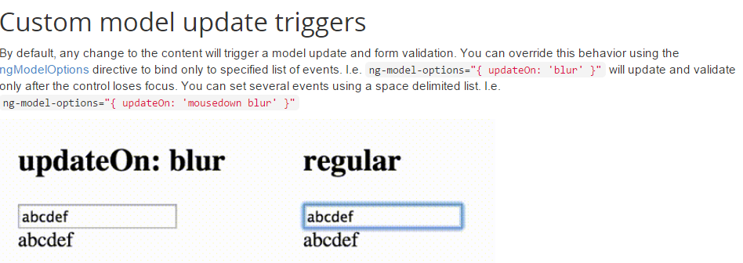
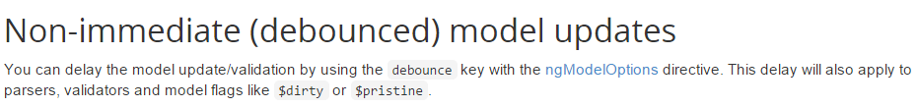
FORM Update events

Slide 15
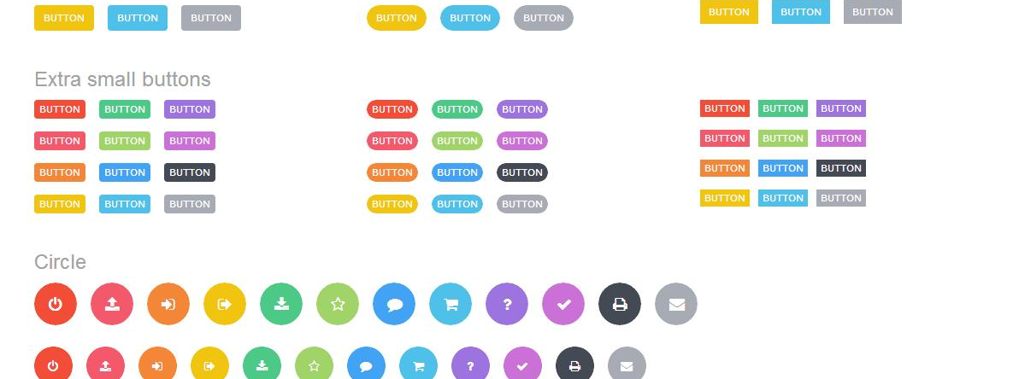
Combo

Slide 16
AngularJS
Use “ng-option” in a <select> component:
ng-option syntax: “select as label for value in array”
select: the returned (selected) value
label: the displayed label for each option
value: the local variable in the loop
array: the array containing the values
<select ng-options="item as item.label for item in items" ng-model="selected"></select>

Slide 17
